Slide 1
Automated Guidance System for Motor Vehicles
TEXAS INSTRUMENT INDIA INNOVATION CHALLENGE

Slide 2

Our Team
Team Members:
Mayank Baranwal
Utkarsh Jain
Srijan Sankrit
Nitin Chauhan
Prateek Manocha
Indian Institute of Technology Guwahati

Slide 3
Our Product
Aim: Curb the rising problem of motor vehicle accidents through the constant monitoring of the vehicles’ surroundings.
Internal monitoring focuses on ensuring the driver is fit to drive
Externally, we intend to provide 360 degree analysis
Warnings of incoming traffic (including pedestrians) in the blind spots
Minimum braking distance (depending on road conditions and speed)
Guides a vehicle steering off course back on the road.

Slide 4
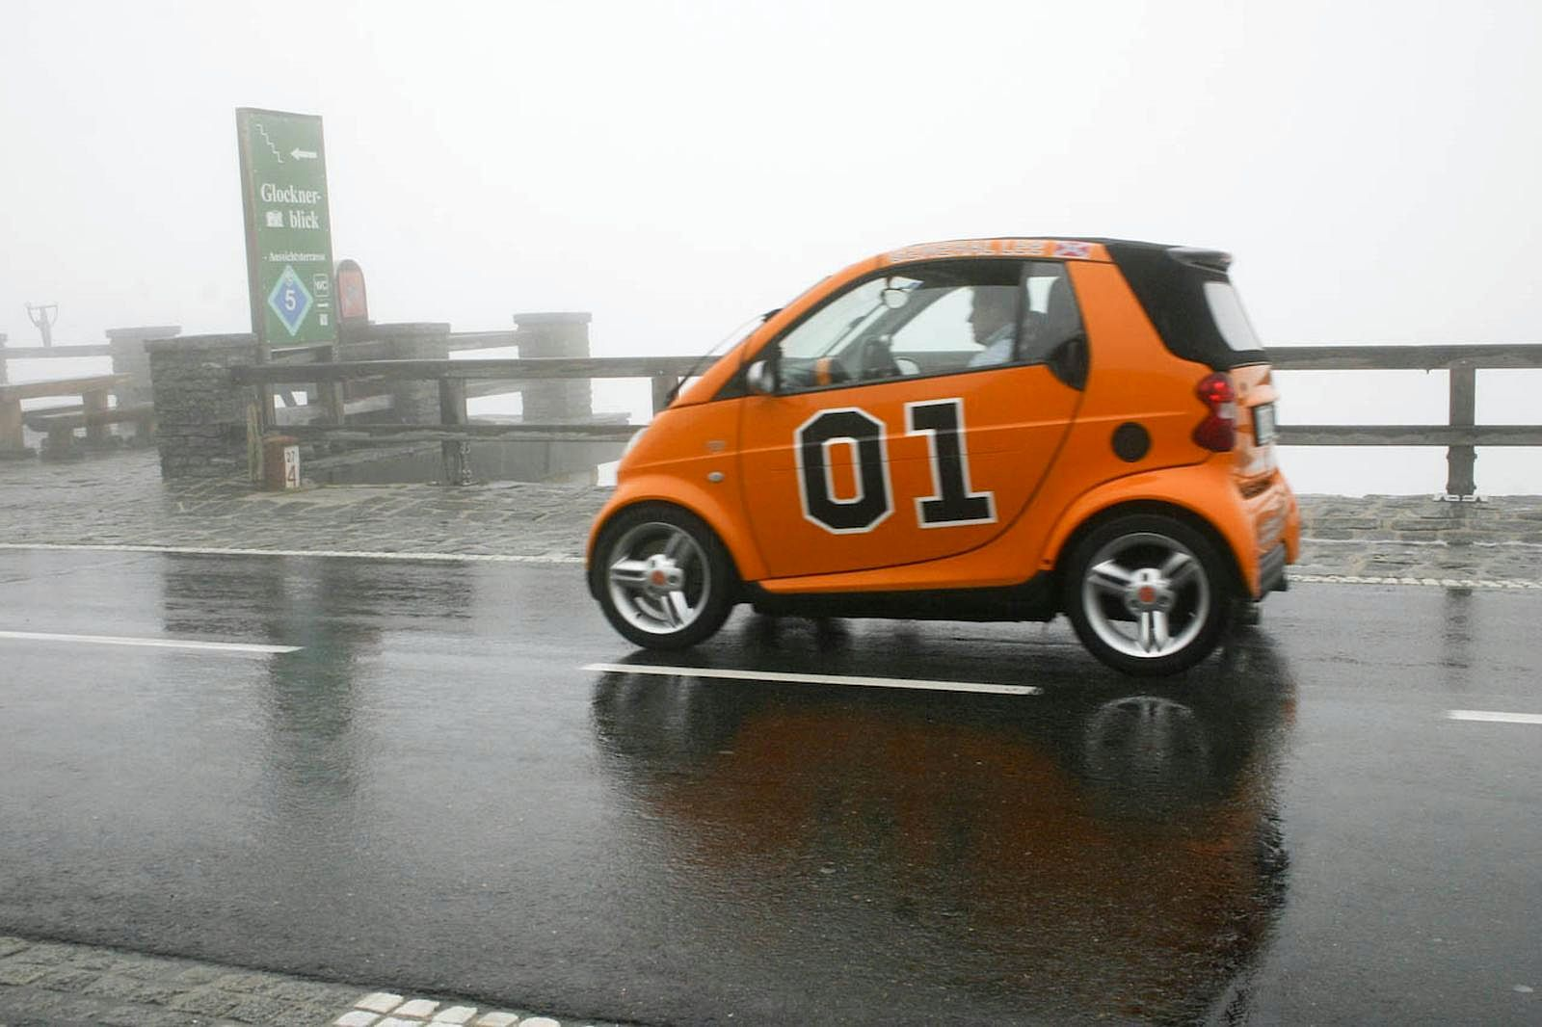
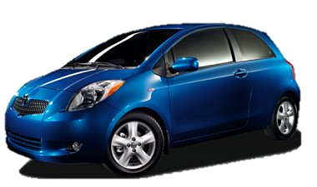

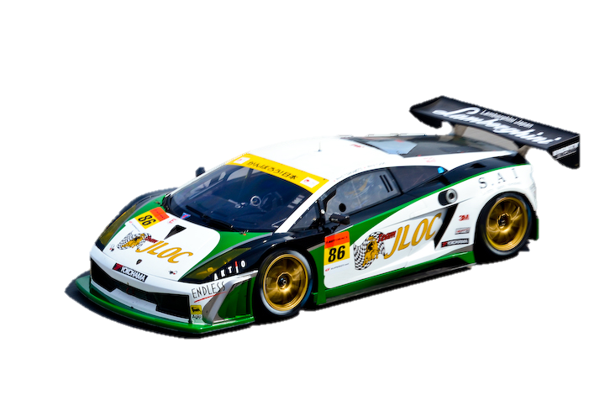
External Analysis

Slide 5
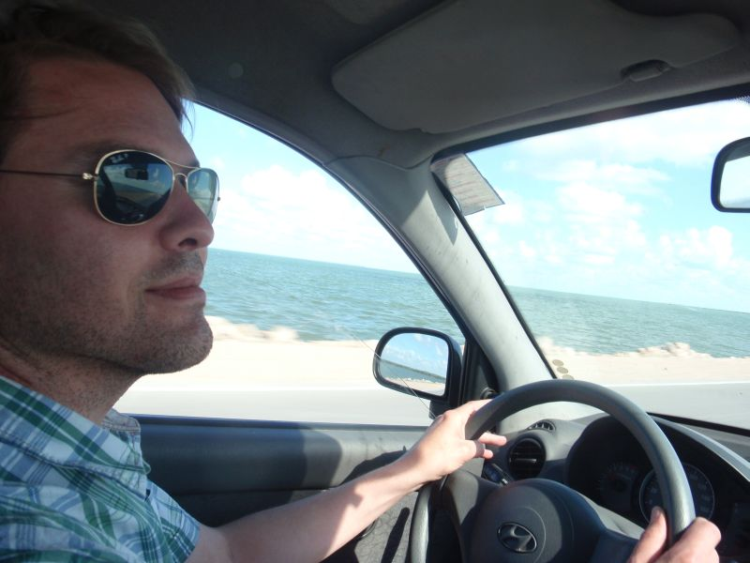
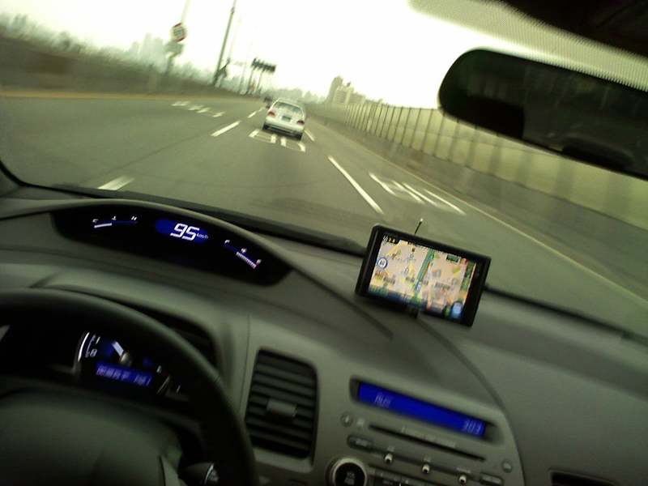
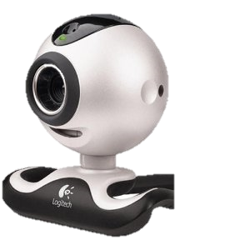
Internal Analysis

Slide 6
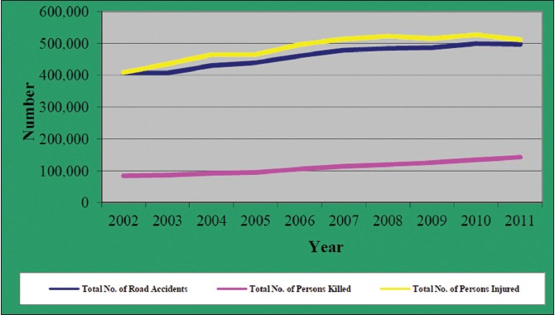
Necessity of our Product
Poor Indian Road Infrastructure:
Annually, 150,000 Indians lose their lives in motor vehicle accidents, making it one of the largest causes of preventable deaths in India.
Monetarily, 55,000 crore (3% of Indian GDP) is lost through road accidents (according to the transport ministry of India)

Slide 7

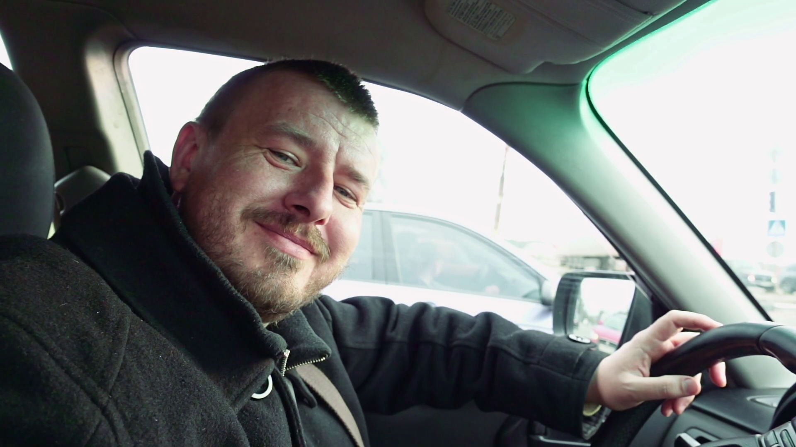
Solution Effectiveness
Our system can sense and identify obstacles up to 100m and provide an 85% accuracy in recommending the next course of action.
Control stress levels of the people at the wheel
Accurate Results

Slide 8
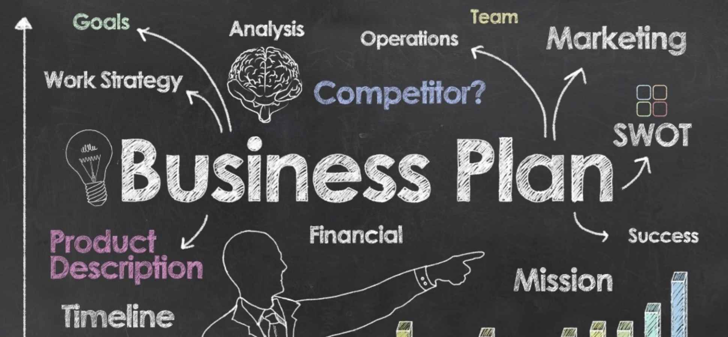
Business Model
Since the product is one of its own, we want to distribute the product to more and more people.
Distribution channel strategy is three-fold
Tie-ups with car manufacturers, transport service providers
Retail market chains
Online marketing through own website and online retailers

Slide 9
THANK YOU

